Slide 1

AI-Powered Loan Approval Prediction System
End-to-end machine learning pipeline on Databricks transforming credit risk assessment
IDC CHALLENGE HACKATHON
MACHINE LEARNING

Slide 2

The Challenge: Automating Loan Decisions
Critical Pain Points
Manual review takes ~30 minutes per application
Inconsistent decision-making across officers
Cannot capture complex financial relationships
Slow adaptation to economic changes
AI Solution: Binary classification predicting Approved (1) or Rejected (0) with probability scores for 50,000 loan applications.

Slide 3

Why AI Over Traditional Rules
Pattern Recognition
Confidence Scores
Captures non-linear relationships across 20+ financial variables that rules miss
Provides probabilistic predictions for borderline cases requiring review
Consistent Decisions
Hidden Risk Detection
Eliminates human bias and ensures fair lending at scale
Identifies emerging patterns and risk factors automatically

Slide 4
Data Foundation: 50,000 Applications
50K
20
27
Total Records
Features
Total Variables
Comprehensive 2025 dataset
Demographics, credit, income, loan details
17 original + 10 engineered features
Feature Engineering
Created 10 sophisticated features to enhance predictions:
credit_tier: Excellent/Good/Fair/Poor/Very Poor
net_worth: savings_assets - current_debt
risk_score: Weighted composite of defaults, delinquencies, marks
employment_stability: years_employed / age ratio

Slide 5
Key Insight #1: Credit Tier Drives Approval
89%
85%
75%
Excellent Credit
Good Credit
Fair Credit
2,591 applications
7,104 applications
13,417 applications
51%
14%
Poor Credit
Very Poor Credit
14,395 applications
12,493 applications
Critical Finding: 53.8% of applicants fall into Poor/Very Poor tiers — opportunity for credit improvement programs.

Slide 6
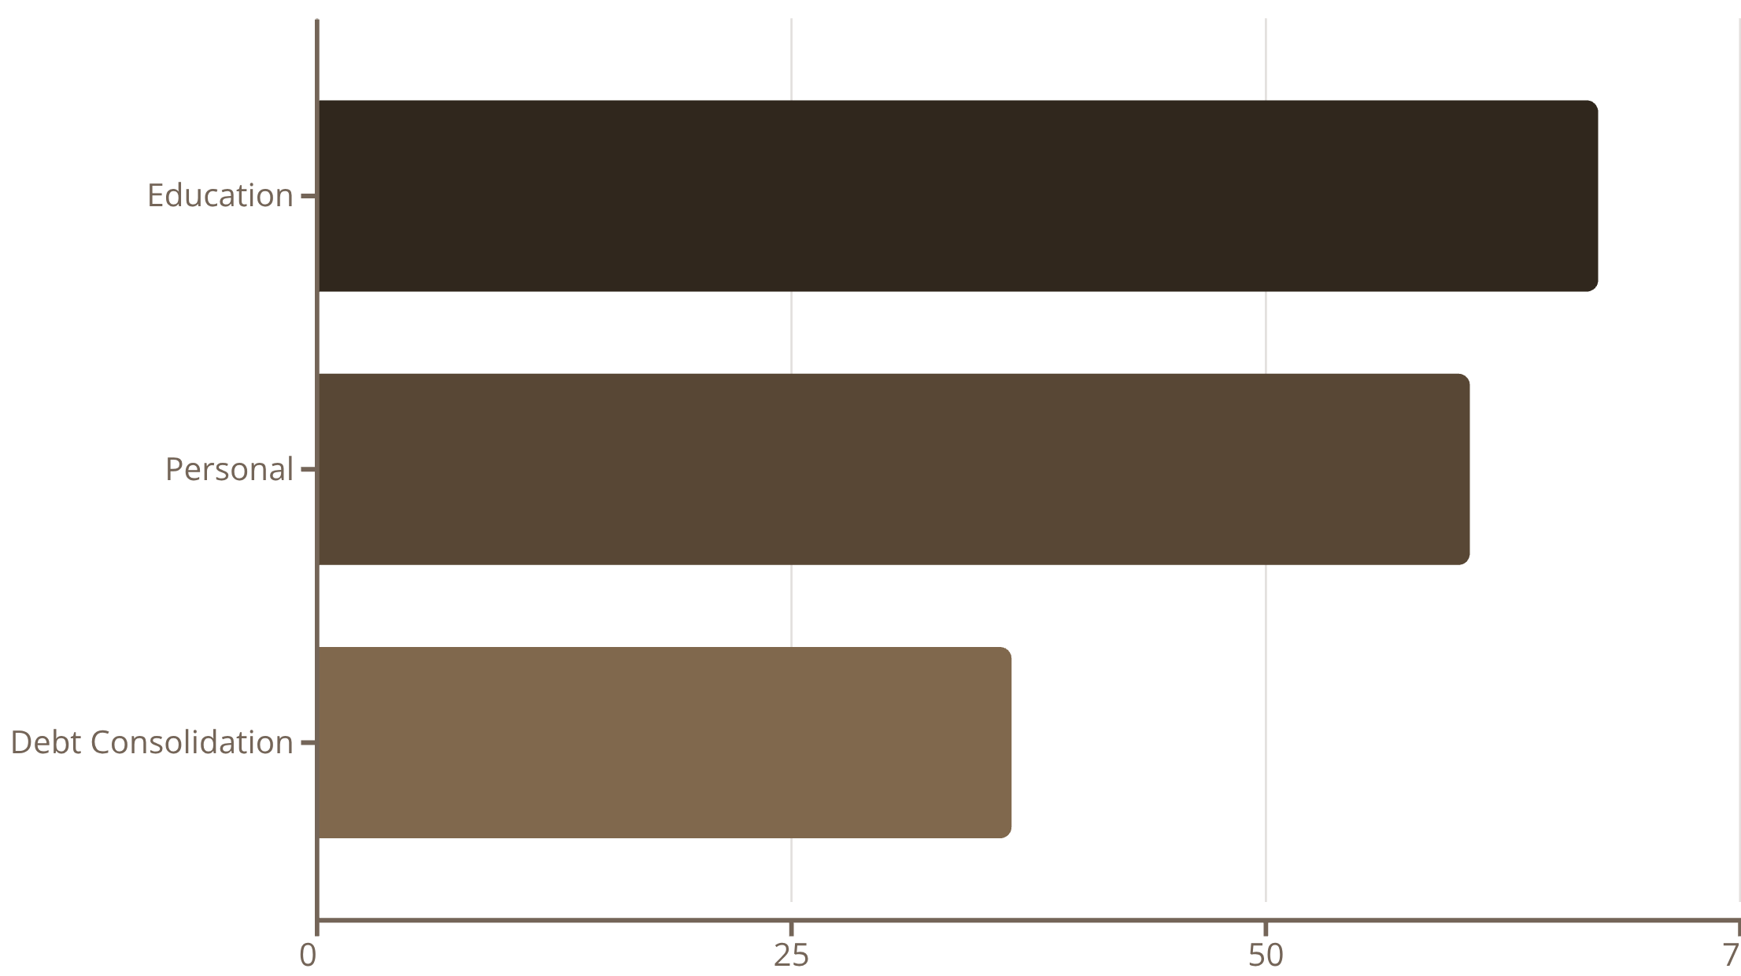
Key Insight #2: Loan Purpose Reveals Risk
Strategic Implications
Education Loans
Highest approval (67.51%), lowest risk score (8.92) — prioritize marketing
Debt Consolidation
63.35% rejection rate signals financial distress — require additional scrutiny
Recommendation: Implement differentiated interest rates by loan purpose.

Slide 7



Model Performance: Exceptional Results
98%
92%
AUC-ROC Score
Accuracy
0.9799 — excellent discrimination ability
92.17% correct predictions
92%
92%
Precision
Recall
Minimizes false approvals
Captures worthy applicants
Model Choice: Gradient Boosted Trees selected for superior performance on tabular financial data with mixed features. Handles categorical and numerical variables natively while providing interpretable feature importance.

Slide 8

Medallion Architecture: Bronze → Silver → Gold
Bronze
Silver
Gold
End-to-end workflow leveraging Delta Lake tables in Databricks Unity Catalog. Model predictions stored back to Gold layer for business intelligence and audit trails.
01
02
Bronze Layer
Silver Layer
Raw data ingestion with audit metadata
Feature engineering and data transformation
03
04
Gold Layer
MLflow Registry
Business analytics and ML predictions
Model versioning and deployment

Slide 9



Turning Predictions into Decisions
Decision Framework
Auto-Approve
Risk-based automation tiers for operational efficiency
Probability 0.80-1.00 — Fast track processing
Manual Review
Probability 0.40-0.79 — Request additional documentation
Auto-Decline
Probability 0.00-0.40 — Decline or counteroffer

Slide 10


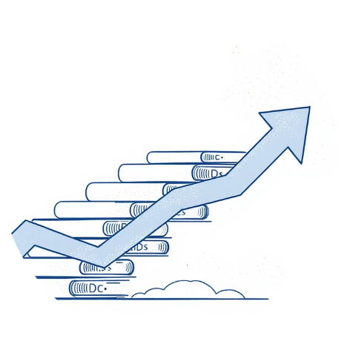

Business Impact: Measurable Value
80% Faster Processing
15% Lower Default Rate
20% More Throughput
40% Cost Reduction
Lower credit assessment labor costs
From 30 minutes to 6 minutes per application
AI screening reduces credit risk exposure
Increased approval volume capacity
Built with Databricks, PySpark, and MLflow — Solving real-world credit risk assessment with AI

